Slide 1
Sprint 2 Delivery
Group 1 - Alex, Angel, Atanas, Stoyan, Tsanko
Notes:
Getting up to speed with Grafana and experiencing the problems ourselves.
Began research into different requirements - performance, usability and expansion. We also looked into the queries that you provided.

Slide 2
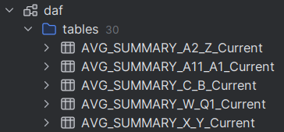
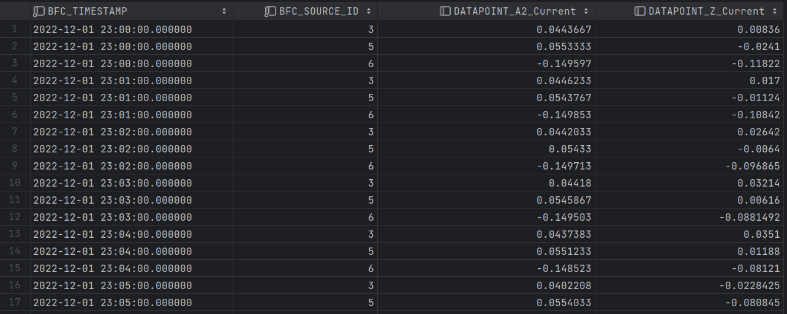
Summary Tables

Slide 3
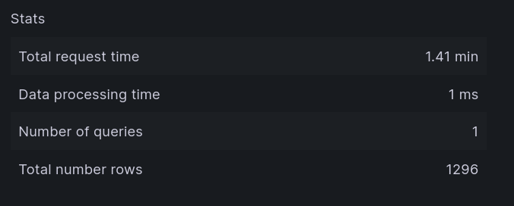
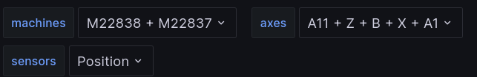

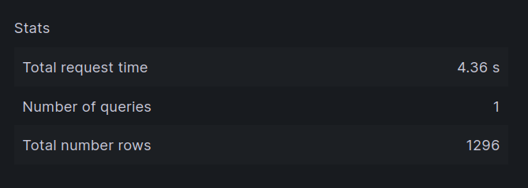

Results

Slide 4
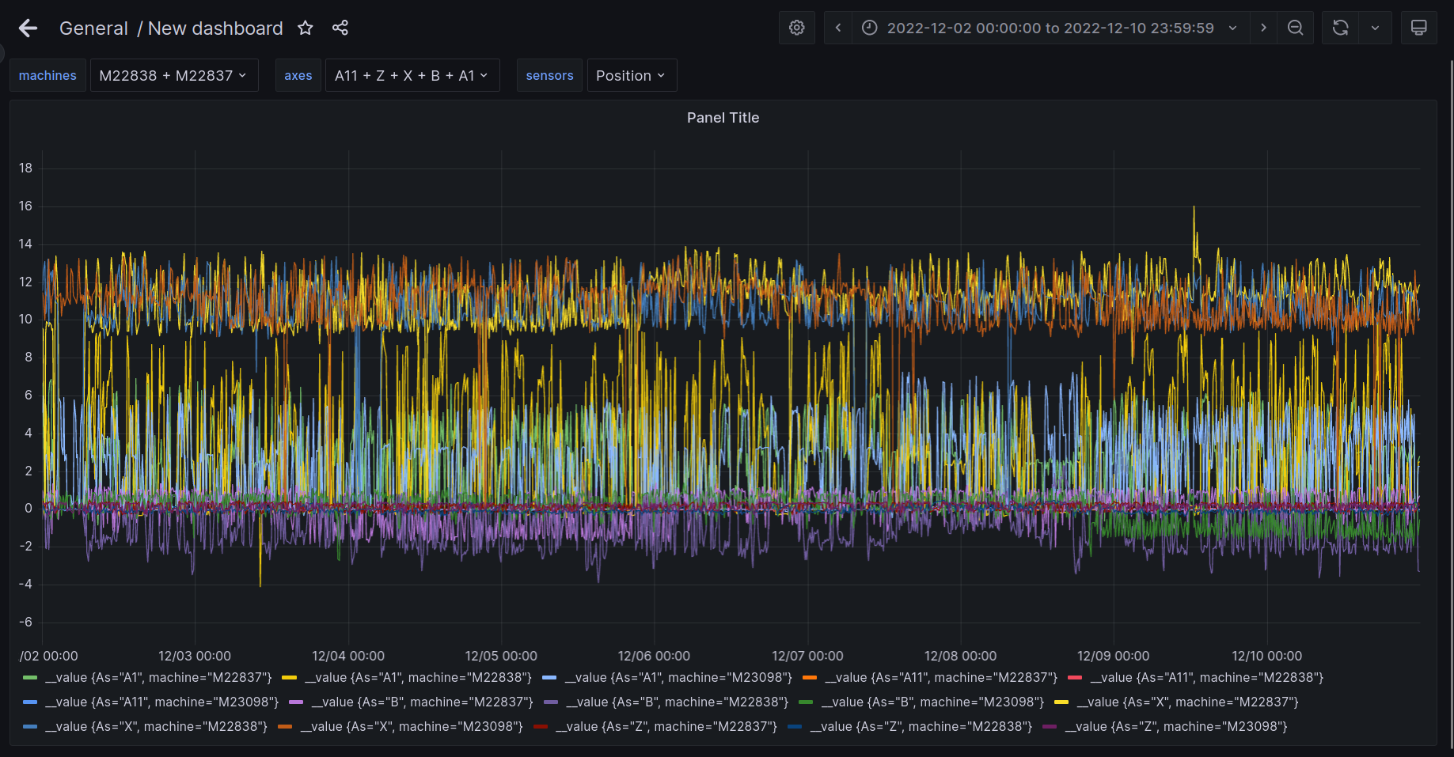

Slide 5
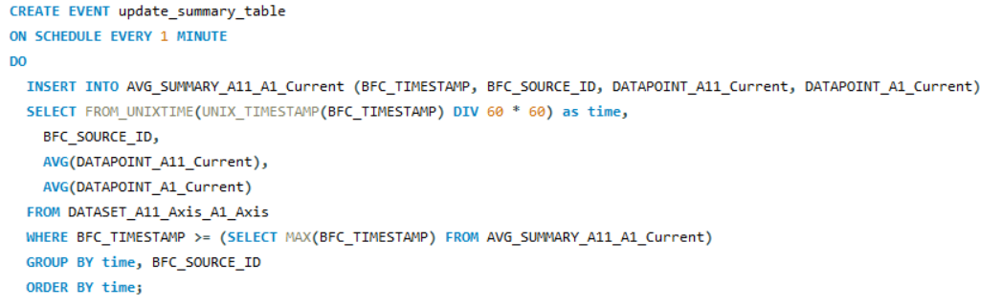
Demo of summary tables with event updating

Slide 6
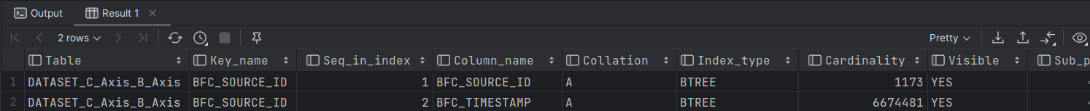

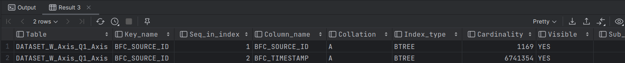
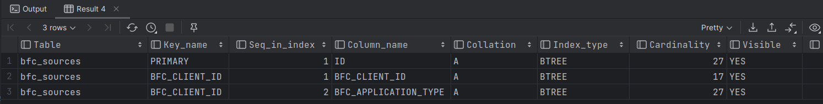
Indexing

Slide 7
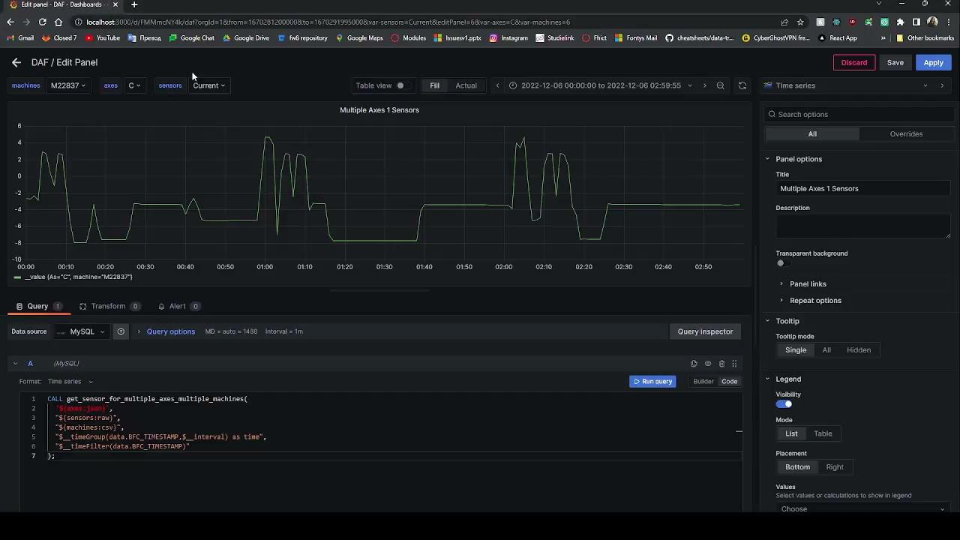
Deliverable: Flexible query

Slide 8
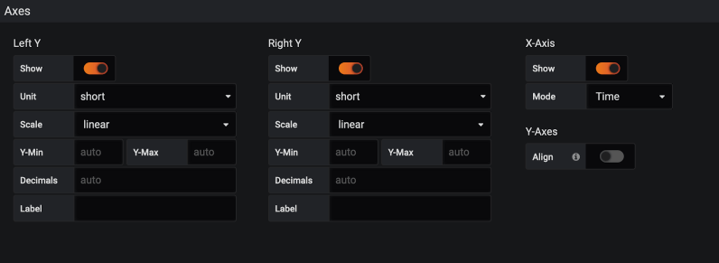
Grafana Chart Normalization
Standard Options
Adjusting “min” and “max” values on the Y-axis scale
Specifying the number of decimals used on rendered values
Predefined specific “Unit” option to be used
Common scaling

Slide 9
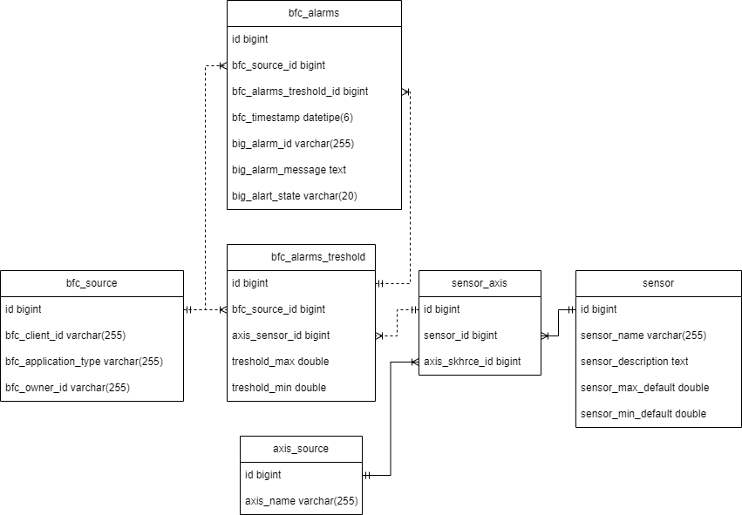
Expansion

Slide 10

Now what?

Slide 11
Thank you for your time

